Slide 1
Welcome to English Class
Unit 9: NATURAL DISASTERS
(lesson 2: review the simple past- past perfect)
Let’s learn English !

Slide 2
Check homework
https://quizizz.com/admin/quiz/5e987d750d3d7e001c6c12ca

Slide 3
Unit 9: NATURAL DISASTERS
Read part of the conversation from getting started
Pay attention to the underlined part.
Nick : Was anyone injured?
Duong: Only a few minor injuries were reported. Most people had moved to safe areas when the storm broke.
Past perfect tense
Form:
S + had + past participle
+ Most people had moved to safe areas when the storm broke.
- Most people hadn’t moved to safe areas when the storm broke.
? Had Most people moved to safe areas when the storm broke?

Slide 4
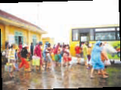
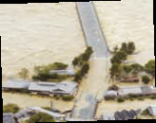
b. When do we use the past perfect? Can you think of any rules?
Unit 9: NATURAL DISASTERS
by 11 o’clock last night
Ex: People had managed to leave the flooded villages by 11 o’clock last night
=>We use the past perfect to describe an action before a started time in the past
when rescue workers arrived
Ex: People had already left the flooded villages when rescue workers arrived.
=>We use the past perfect to describe an action happened before another action in the past, the action happened after used in the simple past.

Slide 6
.Complete the sentences by putting the verbs in brackets into the simple past or past perfect
Unit 9: NATURAL DISASTERS
had left
Most people (leave)………. before the volcano (erupt)………..
By the time we (arrive)…………. at the canyon, It (stop)……….............snowing.
They (spend)…………… the night in the flooded are before help(arrive)……….
Simon (get)……….lost because he (not take) …………. a map with him.
I (find)…………..my pen after I (buy)…………... a new one.
erupted
arrived
had stopped
had spent
arrived
got
hadn’t taken
found
has bought

Slide 7
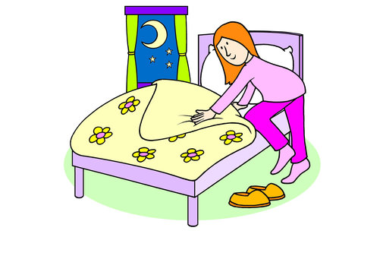
Unit 9: NATURAL DISASTERS
Ask and answer the questions
Do home work
Go to school
- What had he done before he went to school?
- Before he went to school, he had done his homework?
Watch TV
Go to bed
- What had she done by the time she went to bed?
- By the time she went to bed, she had watched TV

Slide 8
MORE EXERCISES BY QUIZ
https://quizizz.com/admin/quiz/5e98808564ea91001b2bc15c

Slide 9
Unit 9: NATURAL DISASTERS (A CLOSER LOOK 2)
* Homework:
- Learn vocabulary by heart and rewrite them in sentences.
Redo the exercise in your notebook.

